Slide 1


Toxic Question Prediction

Slide 2
Topics
Problem / Objective Statement
Tools Utilized
Data Collection / Prepreocessing
Visualize the Data Text Preprocessing
Text Visualizations
Text Modeling
Final Combined Numeric + Text Modeling
Conclusion / Next Steps

Slide 3

Problem / Objective Statement
Quora’s Objective:
Create a machine learning model with > 90% accuracy to predict whether or not a question posted in Quora is considered “toxic”.

Slide 4
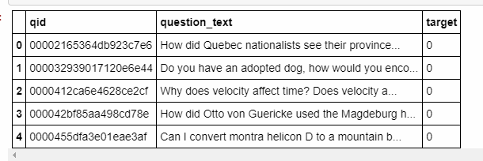
Data Collection / Preprocessing
Kaggle Data
Luckily, we’re dealing with Kaggle Data which is relatively clean.
Utilize NLTK to clean the questions, remove stop words, etc.

Slide 5
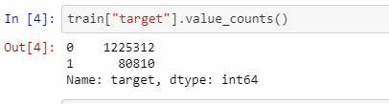
Target Data
Data is not balanced. Overfitting could be an issue

Slide 6
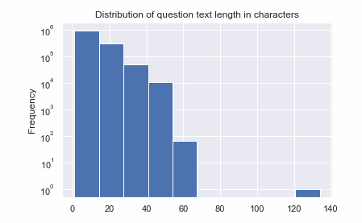
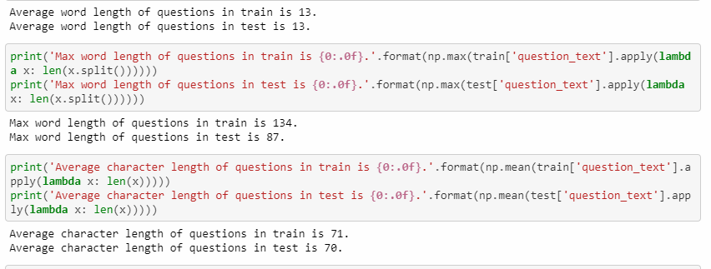
EDA / Visualization
Distribution of question length is right skewed. This is normal since most questions will be shorter.

Slide 7
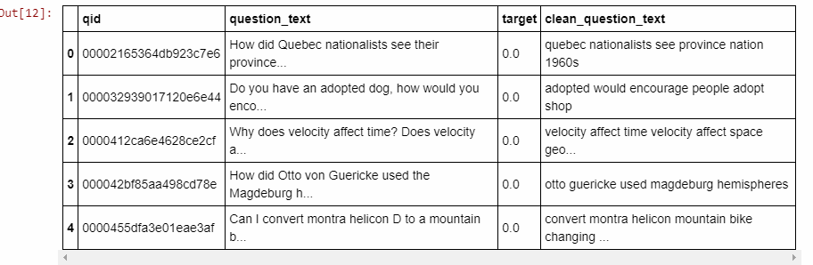
Text Preprocessing
Removed characters that are non-alphanumeric
Down cased all letters
Removed stop words
Utilized NLTK to preprocess NLP data
Final Kept Data for Model

Slide 8
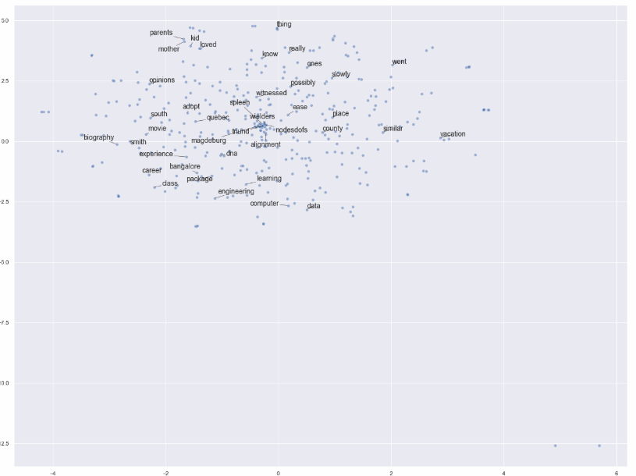
Text EDA – Word2Vec
Engineering, computer, data are close together
Kid, mother, loved are close together

Slide 9
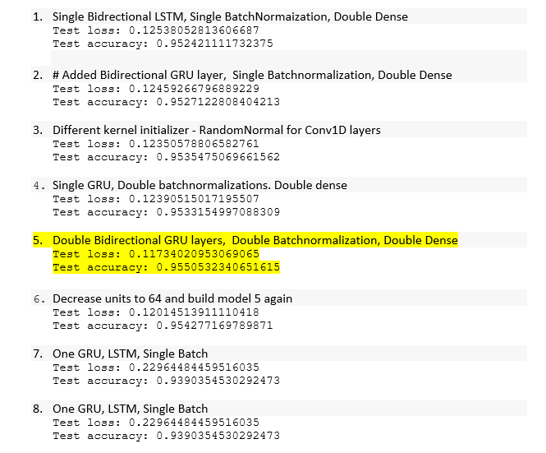
Utilize deep learning algorithm
Best score: highlighted in yellow

Slide 10
Conclusion / Next Steps
Best model seen with double bidirectional GRU layers, with double batch normalization and double dense layers for regularization.
Consider different layers for regularization
Train on a system with more processing power because deep learning took too long to train. - -Consider researching multiprocessing with deep learning training.

